Slide 1
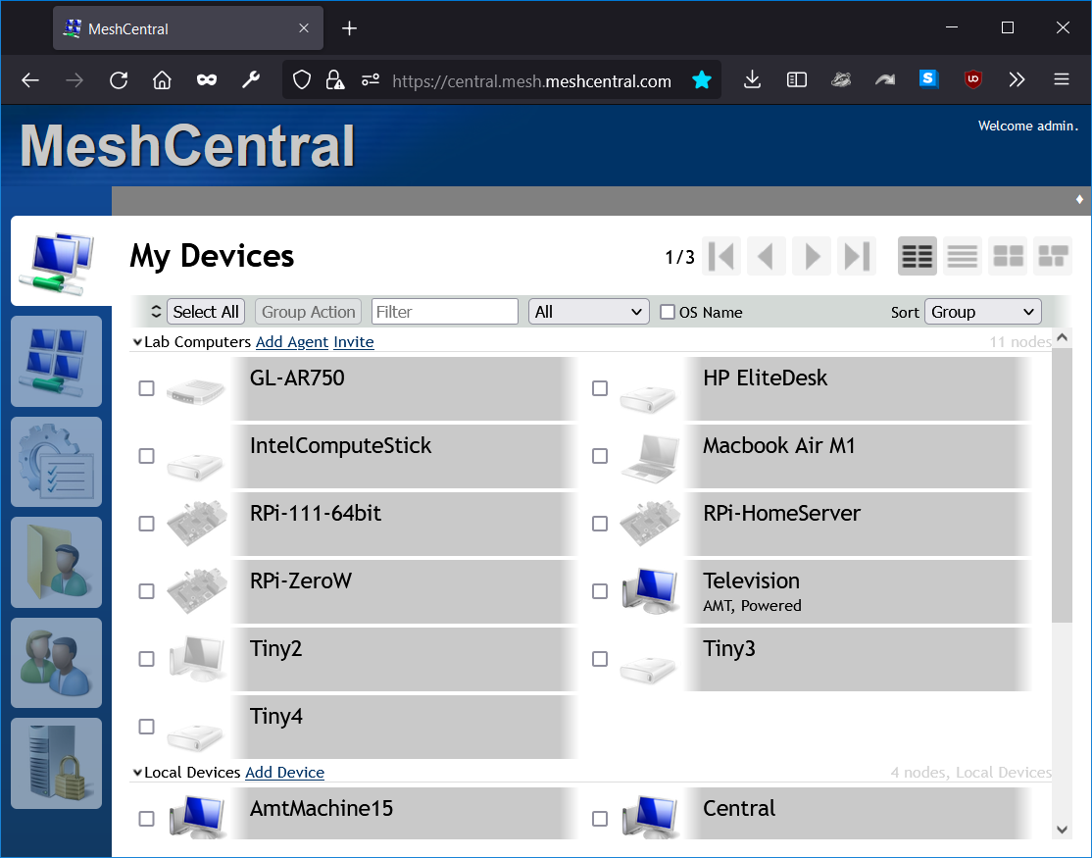
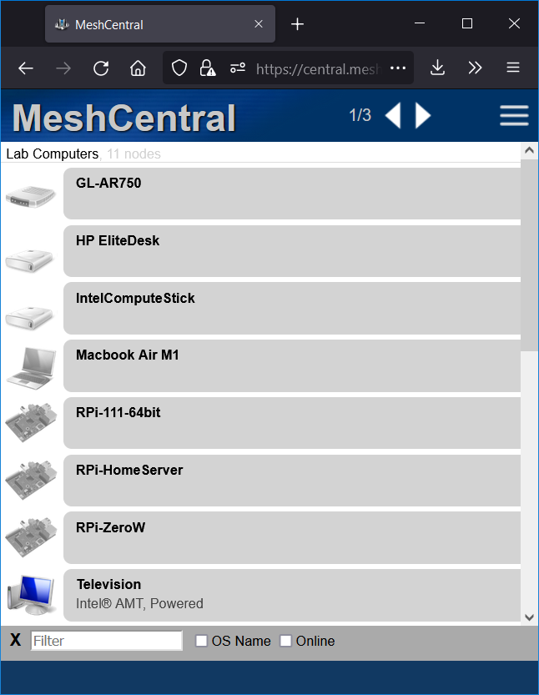

Slide 2

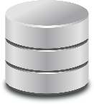


MeshCentral
Database
Event Stream

Slide 3
"domains": {
"": {
"title": "MeshCentral",
"maxDeviceView": 15 }
}

Slide 4

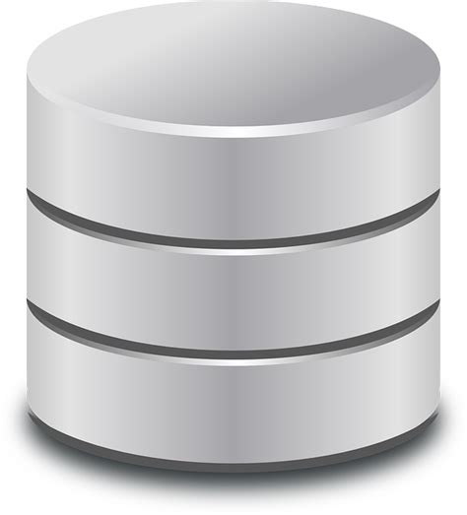
MeshCentral
WRITE
OK
WRITE
OK
WRITE 1
WRITE 2
WRITE 3
OK
{
"settings": {
"port": 443,
"MongoDb": "mongodb://127.0.0.1:27017/?replicaSet=rs0",
"MongoDbName": "meshcentral",
"MongoDbChangeStream": true,
"MongoDbBulkOperations": true
}
}

